Slide 1



SWARNANDHRA VISION
2047
TRIBAL TECH INNOVATORS
SRI GOWTHAM
CBSE SCHOOL
ROBO DOCTOR
FOR
UNREACHABLE
A SMARTER HEALTHCARE SYSTEM FOR A HEALTHIER
ANDHRA PRADESH

Slide 2

HEALTH CARE IS STILL OUT OF REACH
⏳ DELAYED DETECTION
LIMITED ACCESS TO TESTING CAN DELAY IDENTIFICATION OF POSSIBLE HEALTH PROBLEMS.
🏘️ REMOTE VILLAGES
HOSPITALS AND DIAGNOSTIC CENTRES MAY BE FAR AWAY.
💰 COST & ACCESSIBILITY
TRAVEL EXPENSES AND LIMITED TRANSPORT CAN MAKE HEALTHCARE HARDER TO ACCESS.
🛣️ LONG TRAVEL DISTANCES
PEOPLE MAY NEED TO TRAVEL LONG DISTANCES FOR BASIC HEALTH SCREENING.
HEALTHCARE SHOULD REACH PEOPLE — EVEN WHEN THE HOSPITAL IS FAR AWAY
TRIBAL TECH INNOVATORS

Slide 3

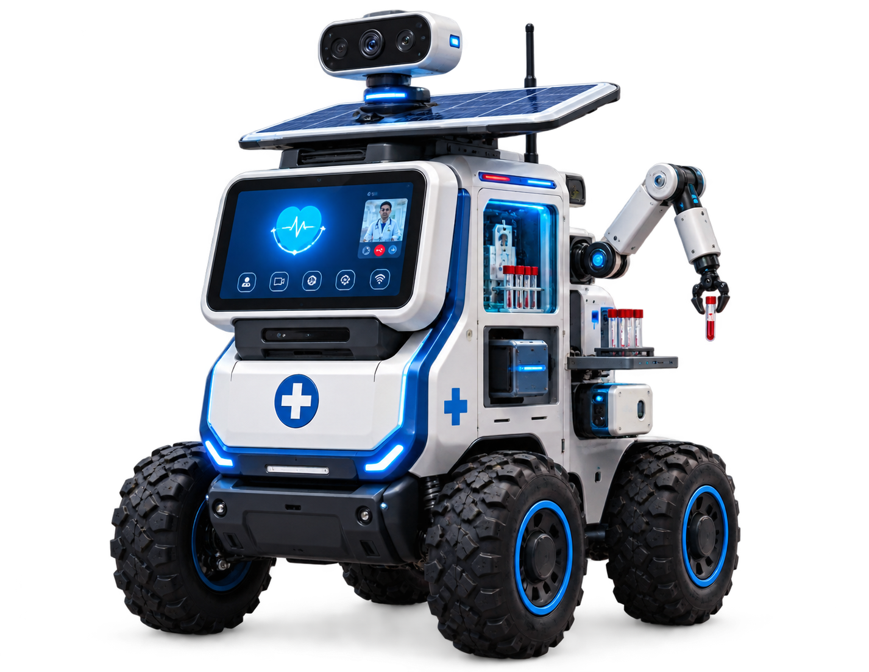
OUR SOLUTION
MEET ROBO DOCTOR 🤖
AI-POWERED HEALTHCARE FOR REMOTE & TRIBAL COMMUNITIES
🩺 Health Screening
🩸 Diagnostic Support
📹 Doctor Video Consultation
🚨 Emergency Assistance
📋 Digital Health Record
🌐 Internet Connectivity
SWARNA ANDHRA@2047
TRIBAL TECH INNOVATORS

Slide 4

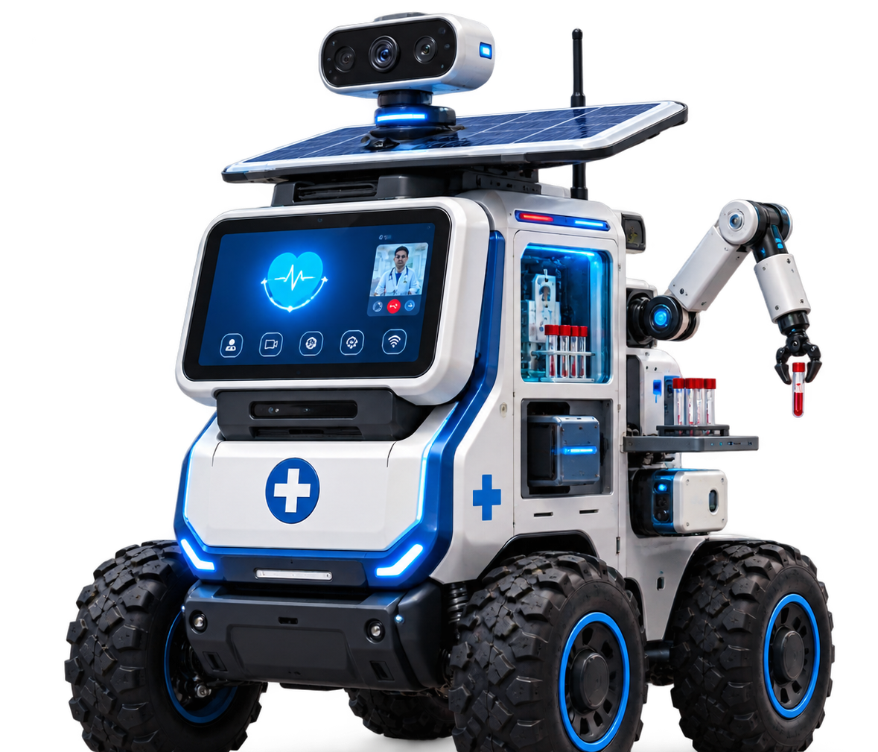
HOW ROBO DOCTOR WORKS-
FROM FIRST INTERACTION TO DOCTOR-ASSISTED HEALTHCARE
👤 PATIENT
🪪 REGISTRATION
❤️ SCREENING
🩸 TESTING
📊 ANALYSIS
👨‍⚕️ DOCTOR
TRIBAL TECH INNOVATORS

Slide 5
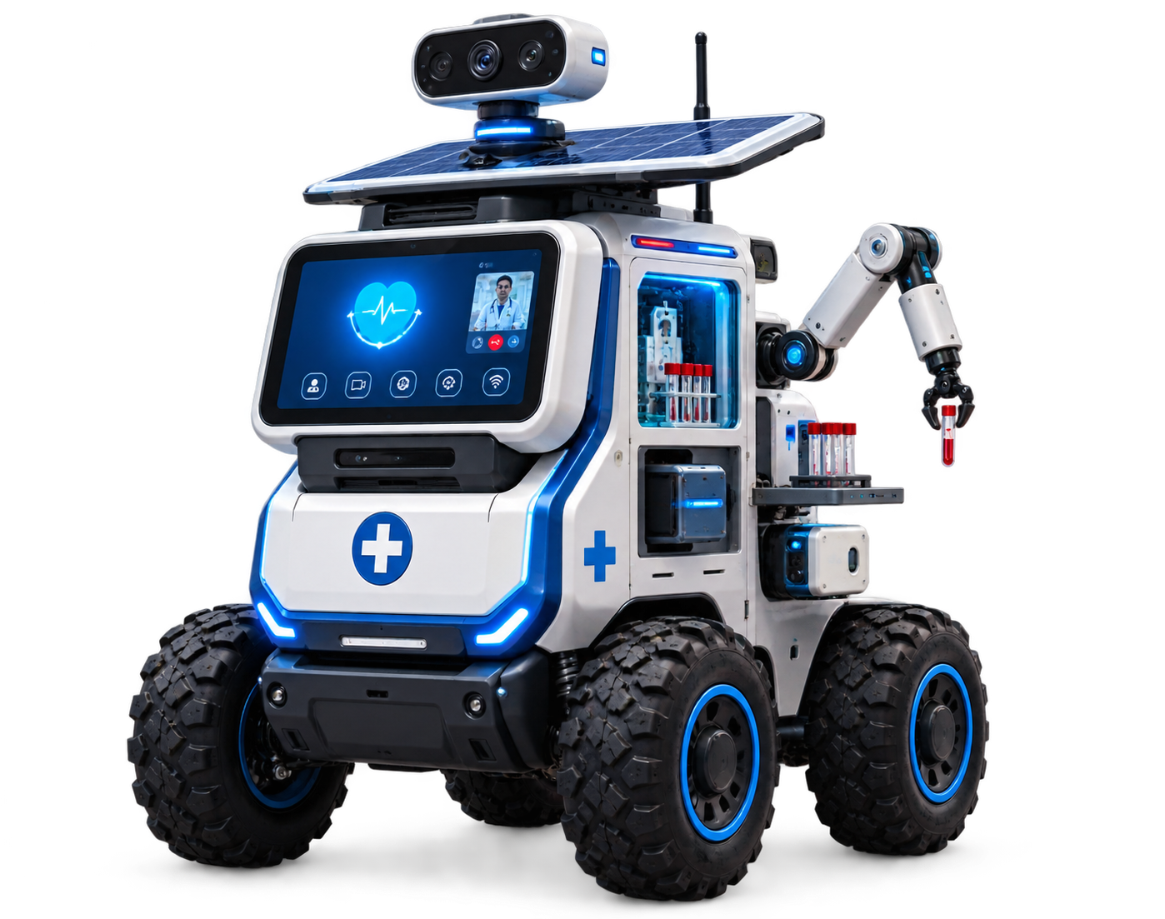
DESIGNED FOR UNREACHABLE
-
ENGINEERING HEALTHCARE ACCESS AROUND THE REALITIES OF REMOTE COMMUNITIES
🛞 01 — ALL-TERRAIN MOBILITY-
  RUGGED WHEELS
  UNEVEN-ROAD CAPABILITY
  COMPACT TURNING RADIUS
  OBSTACLE DETECTION
BUILT TO MOVE BEYOND PAVED ROADS
☀️ 02 — INDEPENDENT POWER
  HIGH-CAPACITY BATTERY
  SOLAR CHARGING OPTION
  LOW-POWER ELECTRONICS
  EXTENDED OPERATING TIME
  DESIGNED FOR AREAS WITH UNRELIABLE ELECTRICITY
📡 03 — CONNECTIVITY + OFFLINE MODE
  INTERNET WHEN AVAILABLE
  LOCAL DATA STORAGE
  AUTOMATIC SYNCHRONIZATION WHEN CONNECTED
  REMOTE DOCTOR COMMUNICATION
  WORKS EVEN WHEN CONNECTIVITY IS LIMITED
🧑‍⚕️ 04 — HUMAN + ROBOT COLLABORATION
  ROBO DOCTOR
  ↓
  SCREENING & DATA
  ↓
  HEALTHCARE WORKER / DOCTOR
  ↓
PATIENT
  TECHNOLOGY SUPPORTS HEALTHCARE PROFESSIONALS

Slide 6
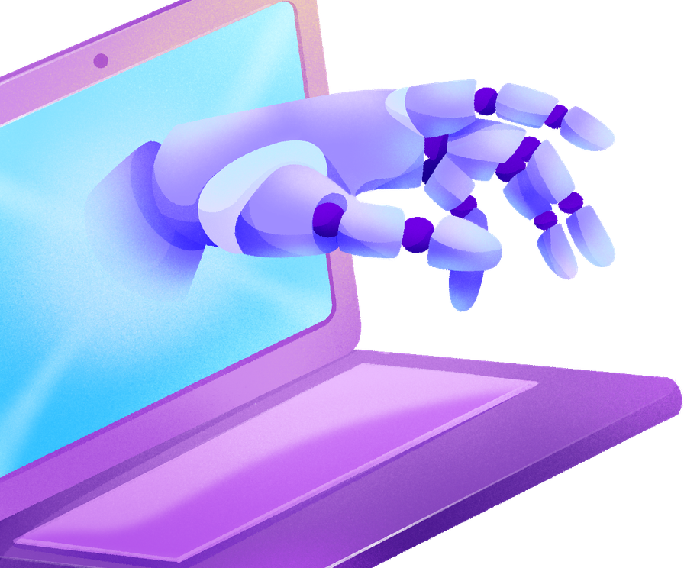
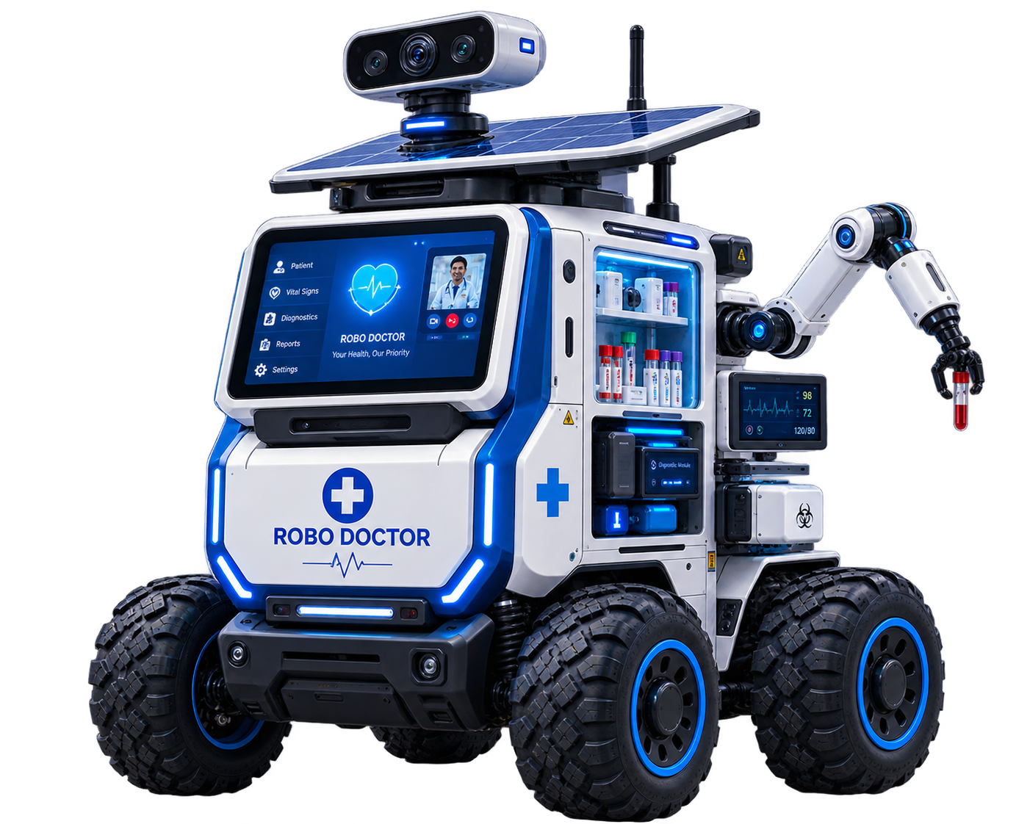
TECHNOLOGY INSIDE ROBO DOCTOR
-AN INTEGRATED SYSTEM COMBINING ROBOTICS, AI, DIAGNOSTICS, CONNECTIVITY AND RENEWABLE POWER
🧠 01 — AI + COMPUTING
📡 03 — CONNECTIVITY
  EDGE AI PROCESSOR
  SENSOR-DATA PROCESSING
  ABNORMAL-INDICATOR DETECTION
  VOICE INTERACTION
  LOCAL DECISION-SUPPORT SOFTWARE
  4G/5G CONNECTIVITY
  WI-FI
  GPS
  HD CAMERA
  MICROPHONE + SPEAKER
  DOCTOR VIDEO CONSULTATION
2047
🔋 04 — POWER SYSTEM
🩺 02 — MEDICAL & DIAGNOSTIC SYSTEM
  RECHARGEABLE BATTERY
  BATTERY-MANAGEMENT SYSTEM
  SOLAR CHARGING OPTION
  POWER-EFFICIENT ELECTRONICS
  LONG OPERATING DURATION
  VITAL-SIGN SENSORS
  BLOOD-PRESSURE MONITORING
  OXYGEN SATURATION
  TEMPERATURE MEASUREMENT
  SELECTED BLOOD-BASED TESTING
  DIAGNOSTIC MODULE
🛞 05 — ROBOTICS & MOBILITYY
  HIGH-TORQUE MOTORS
  RUGGED WHEELS
  MOTOR CONTROLLERS
  OBSTACLE DETECTION
  GPS-ASSISTED NAVIGATION
  EMERGENCY STOP SYSTEM

Slide 7
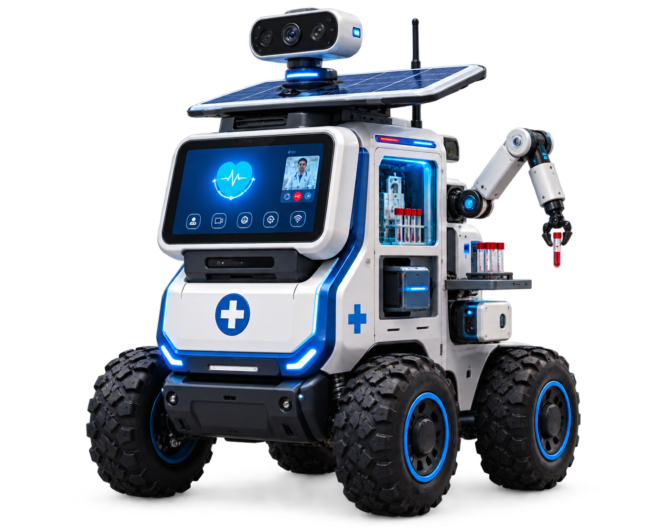
PROTOTYPE COST ESTIMATION
-ESTIMATED INVESTMENT FOR DEVELOPING ONE FUNCTIONAL ROBO DOCTOR PROTOTYPE
ROBOTIC CHASSIS & BODY
HEALTH MONITORING SENSORS
OPTIONAL SOLAR CHARGING
₹35,000
₹20,000
₹30,000
MOTORS, WHEELS & CONTROLLERS
DIAGNOSTIC / BLOOD-TESTING MODULE
GPS & OBSTACLE DETECTION
₹30,000
₹15,000
₹60,000
DISPLAY, CAMERA & AUDIO
CONNECTIVITY & COMMUNICATION
SOFTWARE / AI / DASHBOARD
₹20,000
₹35,000
₹15,000
NOTE: THIS IS A PRELIMINARY PROTOTYPE ESTIMATE. FINAL COST WILL DEPEND ON MEDICAL-GRADE COMPONENTS, DIAGNOSTIC EQUIPMENT, CERTIFICATION, SOFTWARE ARCHITECTURE, MANUFACTURING SCALE AND PROCUREMENT SPECIFICATIONS.
AI / EDGE COMPUTING SYSTEM
BATTERY & POWER MANAGEMENT
SAFETY & PROTECTIVE ENCLOSURE / MISC. PROTOTYPING
₹35,000
₹25,000
₹40,000

Slide 8
IMPACT ON TRIBAL COMMUNITIES
-Bringing healthcare access closer to people who live far from hospitals
01 — ACCESS TO HEALTHCARE
02 — EARLY IDENTIFICATION
HEALTHCARE SCREENING BECOMES AVAILABLE CLOSER TO REMOTE COMMUNITIES, REDUCING THE NEED FOR EVERY PATIENT TO TRAVEL LONG DISTANCES FOR INITIAL ASSESSMENT.
REGULAR SCREENING CAN HELP IDENTIFY ABNORMAL HEALTH INDICATORS EARLIER AND SUPPORT TIMELY REFERRAL TO HEALTHCARE PROFESSIONALS.
03 — DIGITAL CONNECTIVITY
04 — INCLUSIVE DEVELOPMENT
PATIENT INFORMATION AND TEST RESULTS CAN BE SHARED DIGITALLY, HELPING CONNECT REMOTE COMMUNITIES WITH QUALIFIED DOCTORS.
COMBINES ROBOTICS, AI, HEALTHCARE AND CONNECTIVITY TO EXTEND THE BENEFITS OF TECHNOLOGY BEYOND URBAN AREAS.

Slide 9
FROM PROTOTYPE TO A CONNECTED HEALTHCARE NETWORK
-
BUILDING A SCALABLE HEALTHCARE-SUPPORT SYSTEM FOR REMOTE COMMUNITIES
01 — PROTOTYPE
-
Build and test the first ROBO DOCTOR
FOCUS: SAFETY • MOBILITY • SCREENING • CONNECTIVITY
02 — PILOT VILLAGES
Test the system in selected remOTE COMMUNITIES
FOCUS: REAL-WORLD USABILITY • COMMUNITY FEEDBACK
-
03 — REMOTE HEALTHCARE NETWORK
-
CONNect multiple Robo Doctors with healthcare prOFESSIONALS
FOCUS: TELECONSULTATION • DIGITAL RECORDS • REMOTE SUPPORT
04 — 2047 VISION
-
EXPAND the model to more underservED COMMUNITIES
FOCUS: ACCESSIBLE • CONNECTED • TECHNOLOGY-ENABLED HEALTHCARE

Slide 10
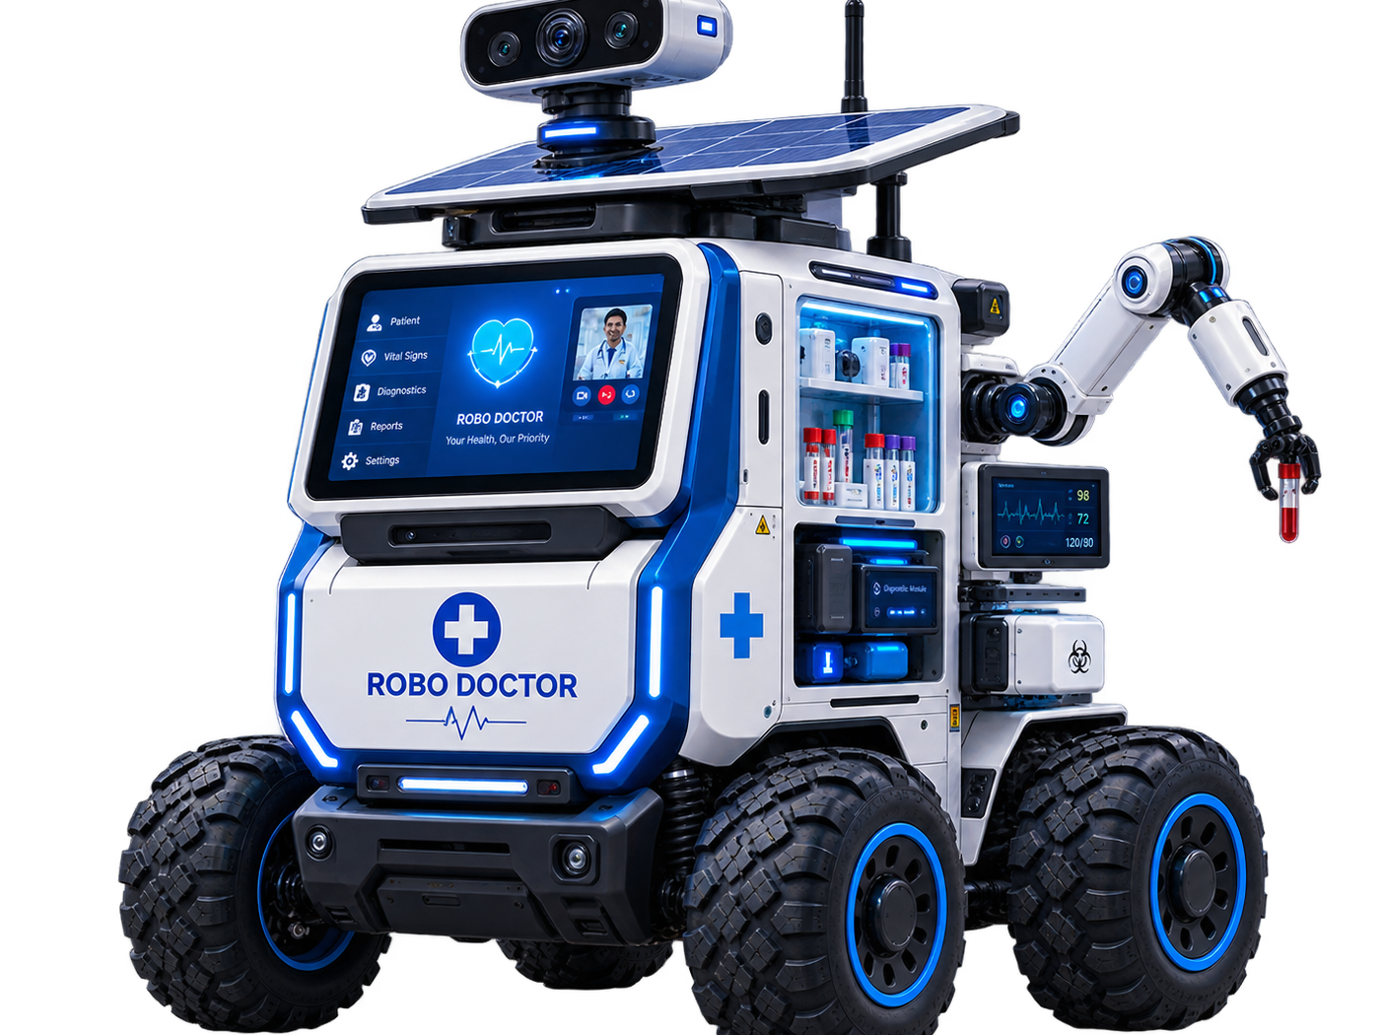
FROM AN IDEA-TO A WORKING PROTOTYPE
WE ARE TRIBAL TECH INNOVATORS FROM SRI GOWTHAM CBSE SCHOOL.
OUR IDEA, ROBO DOCTOR, IS DESIGNED TO EXPLORE HOW ROBOTICS, AI, DIAGNOSTICS AND CONNECTIVITY CAN HELP BRING HEALTHCARE SUPPORT CLOSER TO REMOTE AND TRIBAL COMMUNITIES.
WE RESPECTFULLY REQUEST THE OPPORTUNITY TO TAKE THIS IDEA FORWARD AND BUILD A WORKING PROTOTYPE IF OUR PROJECT IS SELECTED.
WE MAY BE STUDENTS TODAY, BUT WE ARE READY TO TURN OUR IDEA INTO SOMETHING REAL.
TEAM — TRIBAL TECH INNOVATORS
CHARAN KANDULA
TEJA BELAMKONDA
MOHAN DODDA
“DON'T JUST IMAGINE THE FUTURE. BUILD IT.”
SATWIK KOMMULA

